Slide 1
AI Communication Protocols and Agent Interaction

Slide 2
1 Understanding Model Context Protocol for Enhanced AI Communication

Slide 3
Defining MCP's Role in AI Model Understanding and Interaction
Understanding MCP for AI
Understanding MCP is key to developing AI systems that can effectively process and respond to complex contextual cues, thereby improving overall system intelligence and responsiveness.
People-Centric AI Context
MCP plays a vital role in fostering people-centric AI communication by ensuring models grasp human nuances and intentions, leading to more intuitive and empathetic interactions with users.

Slide 4
Key Components of Model Context Protocol for Semantic Alignment
MCP Components for Context
Key components of MCP include mechanisms for context representation, propagation, and resolution, ensuring that AI models maintain a consistent and accurate understanding across various interactions and data sources.

Slide 5
Implementing MCP for Robust and Coherent AI System Responses
1
Normal System Coherence
2
Implementing MCP for AI
Achieving normal system coherence requires careful design and implementation of communication protocols, ensuring all components work together seamlessly to produce predictable and reliable outcomes.
Implementing MCP involves integrating its protocols into AI architectures, enabling models to dynamically adapt their responses based on real-time contextual shifts and user feedback, ensuring relevance.
3
People-Centric AI Coherence
4
Robust AI Responses
MCP implementation supports people-centric AI by enabling systems to generate coherent and contextually appropriate responses, making interactions feel more natural and aligned with human expectations.
Implementing MCP leads to more robust and coherent AI system responses by providing a structured framework for context management, which is essential for handling complex and dynamic operational environments.

Slide 6
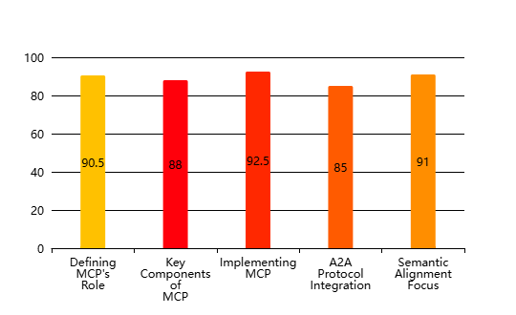
Model Context Protocol (MCP) and A2A Protocol Implementation Strategies
Strategic Implementation of AI Communication Protocols(Effectiveness Score (%))

Slide 7
2 Exploring Agent-to-Agent Protocol for Seamless Multi-Agent Collaboration

Slide 8
Fundamentals of A2A Protocol in Distributed AI Environments
1
2
A2A Protocol's Foundational Aspects
People-Centric AI Communication
This segment outlines the essential components and architectural considerations for implementing robust A2A protocols in complex AI ecosystems.
Explore how A2A protocols facilitate human-like communication patterns within AI systems, emphasizing user experience and intuitive interactions.
3
4
Seamless Multi-Agent Collaboration
Understanding MCP and A2A Basics
Investigate the core mechanisms of A2A that enable efficient and effective collaboration among diverse AI agents in distributed environments.
This section delves into the foundational principles of Model Context Protocol (MCP) and Agent-to-Agent (A2A) Protocol, highlighting their roles in modern AI systems.

Slide 9
Designing Effective A2A Communication for Collaborative Agent Networks
1
Effective Communication Frameworks
2
Optimizing Agent Interaction Strategies
This part details the development of robust communication frameworks that support complex interactions and data exchange among collaborative agents.
Focus on advanced strategies for designing A2A communication that enhances the overall efficiency and effectiveness of agent interactions.
3
Human-Centric Protocol Design
4
Architecting for Multi-Agent Systems
Examine how designing A2A protocols with a people-centric approach can lead to more intuitive and user-friendly AI communication systems.
Discuss best practices for architecting A2A communication within multi-agent systems to ensure seamless and scalable collaboration across networks.

Slide 10
Optimizing Agent-to-Agent Interactions for Collective Intelligence
1
2
Fostering Collective AI Intelligence
Maximizing Agent Network Performance
Explore how optimized A2A interactions contribute significantly to the emergence of collective intelligence within distributed AI agent networks.
This section focuses on methodologies and tools for maximizing the overall performance and responsiveness of agent networks through optimized A2A.
3
4
Advanced Collaboration Techniques
Enhancing MCP and A2A Efficiency
Delve into advanced techniques for improving agent-to-agent collaboration, leading to more sophisticated and intelligent collective behaviors.
Strategies for optimizing the performance and efficiency of both Model Context Protocol and Agent-to-Agent interactions to achieve superior results.

Slide 11
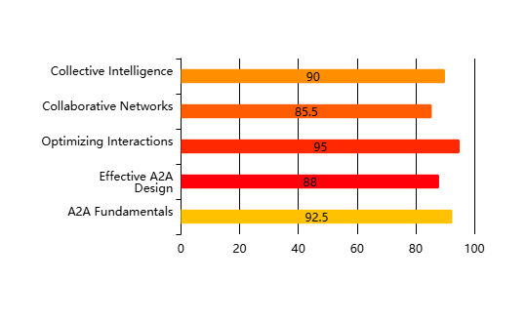
A2A Protocol Effectiveness in Distributed AI
Effectiveness of A2A Protocol Components(Effectiveness Score (%))

Slide 12
Thank You

